Slide 1
Image Processing Project2
2019-05-13

Slide 2
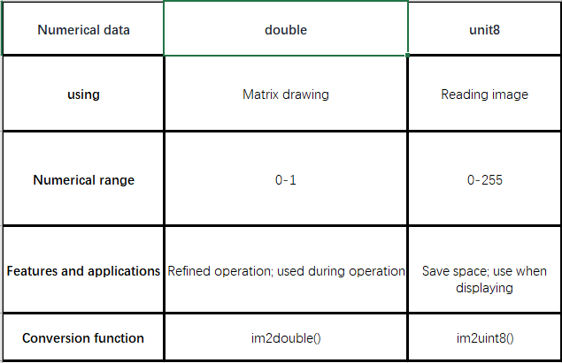
Difference:
Double: double precision numbers in the range 0 to 1.
Unit8: integer data classes.

Slide 3
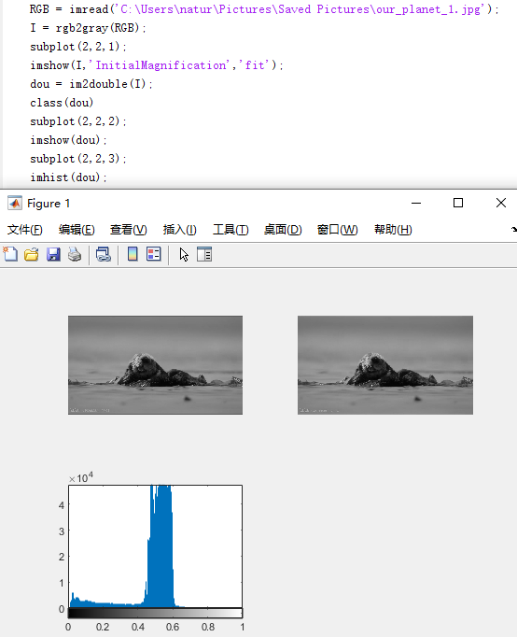
Error:
When performing the operation, the data confirmation needs to be converted into a double type. If the conversion is not performed, the operation overflow will occur and the operation will be terminated.
Use the function inshow() display or imwrite() to write the image, if the data type is double, the output image is likely to be different. For example, imshow() displays an image, and the default double data range is 0-1. Then the element large than 1 in the array is classified as 1 and displayed as white.

Slide 4
XOR/OR Operation
Necessary: two images of the identical size
The XOR and OR operations are performed through a single pass module which during operation passes through the each pixel of each image and calculates the pixels of the output image by doing the respective operation on the corresponding pixels to calculate the output pixels.

Slide 5
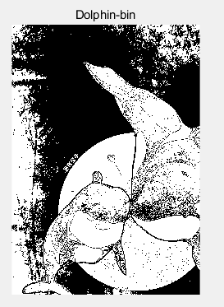
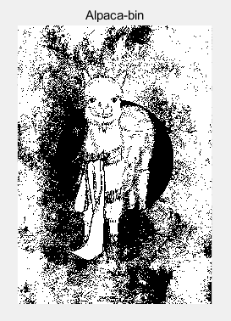
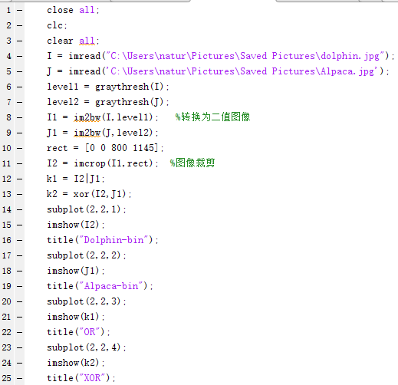
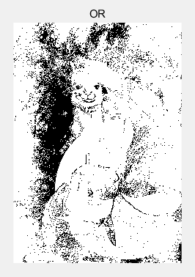
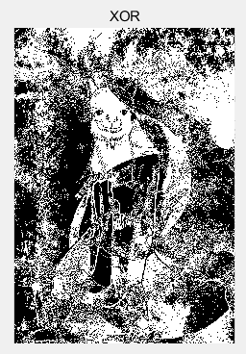

Slide 6
Image noise: is an undesirable by-product of image capture that obscures the desired imformation
Types:
Gaussian noise: statistical noise conforms to Gaussian distribution. Principal sources of Gaussian noise in digital images arise during acquisition. We can reduce by using a spatial filter.
Salt-and-pepper noise: presents itself as sparsely occurring white and black pixels. It can be caused by sharp and sudden disturbances in the image signal. We can reduce by a median filter or a morphological filter. For one, a contraharmonic mean filter can be effective.
Shot noise: is consistent with the Poisson distribution, and the noise is derived from the discrete nature of the charge.
Quantization noise: has an approximately uniform distribution. It caused by quantizing the pixels of a sensed image to a number of discrete levels is known as quantization noise.
Film grain: The grain of photographic film is a signal-dependent noise, with similar statistical distribution to shot noise. If film grains are uniformly distributed (equal number per area), and if each grain has an equal and independent probability of developing to a dark silver grain after absorbing photons, then the number of such dark grains in an area will be random with a binomial distribution. In areas where the probability is low, this distribution will be close to the classic Poisson distribution of shot noise.
Anisotropic noise: Some noise sources show up with a significant orientation in images.
Periodic noise: A common source of periodic noise in an image is from electrical or electromechanical interference during the image capturing process. An image affected by periodic noise will look like a repeating pattern has been added on top of the original image.

Slide 7
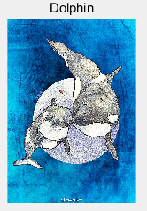
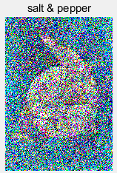
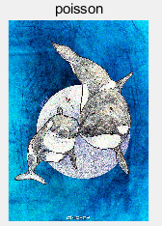
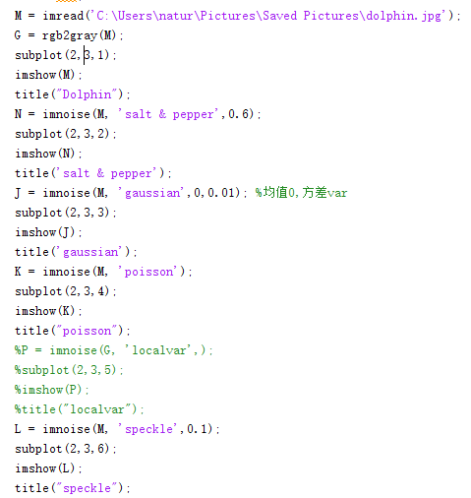
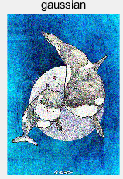
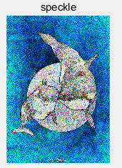
Add some noise:

Slide 8
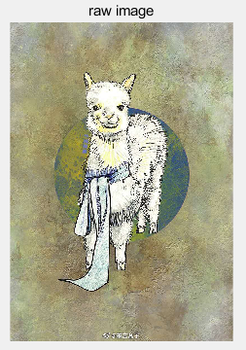
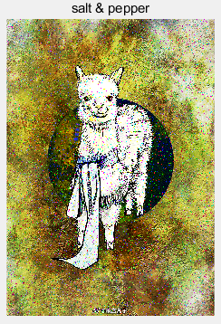
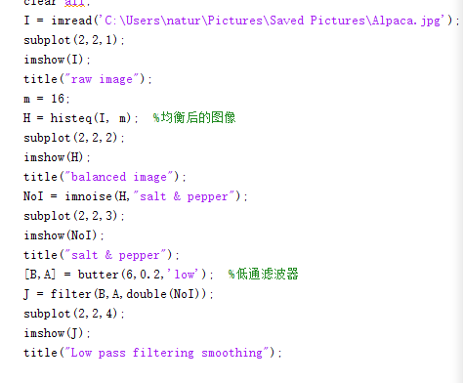
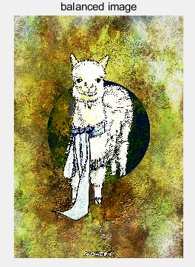
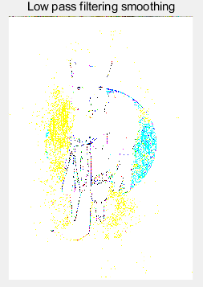
Filter: 1-D digital filter, multiple pixels in the original image are used to calculate each new pixel. A filter is represented by a “filtering matrix”(or “filtering template”) whose import parameters include “the size of the filtering region” and “the shape of the filtering region”

Slide 9
Linear filters (linear convolution):
Box filter: b = imboxfilt(A, filterSize, Name, value) ，the current pixel and its adjacent pixels are treated equally, and the average processing is performed uniformly.
Gaussian filter: Each template in the image is scanned with a template (or convolution, mask), and the value of the center pixel of the template is replaced by the weighted average gray value of the pixels in the neighborhood determined by the template.
Differential filter:

Slide 10
Nonlinear filter:
Minimum and maximum filtering:
Median filtering: Such noise reduction is a typical pre-processing step to improve the results of later processing. Under certain conditions, it preserves edges while removing noise. It applies to salt and pepper noise.
Weighted median filtering:

Slide 11
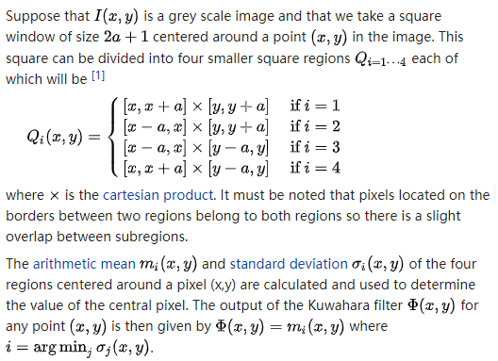
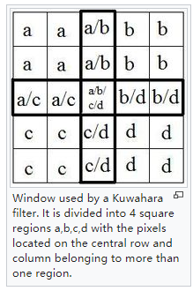
Kuwahara filter: nonlinear , the Kuwahara filter is able to apply smoothing on the image while preserving the edges.

Slide 12


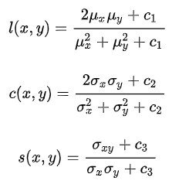
Evaluation:
MSE:
PSNR:
SSIM: bases on luminance, contrast and structure.

Slide 13
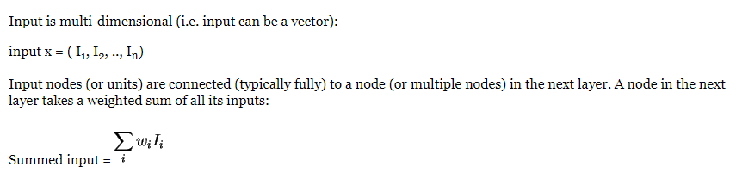
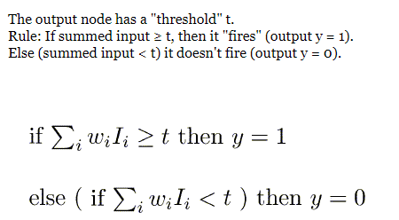
Single-layer Neural Networks: from multi-dimensional real input to binary output. The perceptron is separating the input into 2 categories.

Slide 14
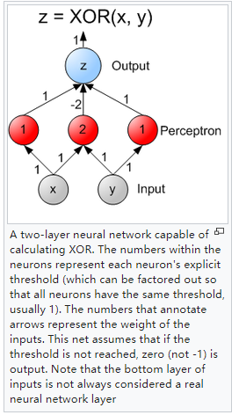
Feedforward neural network:
In this network, the information moves in only one direction, forward, from the input nodes, through the hidden nodes (if any) and to the output nodes. There are no cycles or loops in the network.
The single-layer network is identical to the logistic regression model.
Single-layer perceptrons are only capable of learning linearly separable patterns. The multi-layer perceptrons are capable of producing any possible boolean function

